Slide 1
UNIT IV
HIVE

Slide 2
HIVE
Introduction to Hive
Hive Architecture
Hive Data Types
Hive File Format
Hive Query Language (HQL)
User-Defined Function (UDF) in Hive.

Slide 3
HIVE
Hive is a Data Warehousing tool.
Developed by Facebook to manage their ever-growing volumes of log data in the year 2007.
In 2008 it became Apache Hadoop sub-project.
Hive is used to query structured data built on top of Hadoop.
It resides on top of Hadoop to summarize Big Data, and makes querying and analyzing easy.
Hive makes use of the following:
HDFS FOR storage
MapReduce for execution
Stores metadata in an RDBMS

Slide 4
HIVE
HIVE is a data warehousing tool.
Hive suitable for Data warehousing applications.
Hive processes batch jobs on huge data that is immutable.
Web logs, Applications logs.

Slide 5
Recent Releases of HIVE
Hive 0.10
Batch
Read-Only Data
HiveQL
MR
Hive 0.13
Interactive
Read-Only Data
Substantial SQL
MR, TEZ
Hive 0.14
Transactions with ACID semantics
Cost based optimizer
SQL temporary tables.

Slide 6
Features of Hive
It is similar to SQL.
It provides SQL type language for querying called HiveQL or HQL, which is easy to code.
Hive supports rich data types such as structs, lists, and maps.
Hive suppots SQL filters, group-by and order-by clauses.
Custom types, custom functions can be defined.

Slide 7
Hive Data Units
Databases : The namespace for tables
Tables: Set of records that have similar schema.
Partitions: Logical separations of data based on classification of given information as per specific attributes.
Buckets or clusters : Similar to partitions but uses hash function to segregate data and determines the cluster or bucket into which the record should be placed.

Slide 8
Data units arranged in HIVE
Databases
Tables
Tables
Partitions
Buckets
Columns
Columns
Columns
Columns
Data
Data

Slide 9
Hive data units
A database contains several tables.
Each table is constituted of rows and columns.
In Hive tales are stored as a folder
Partition tables are stored as sub-directory.
Bucketed tables are stored as a file.

Slide 10
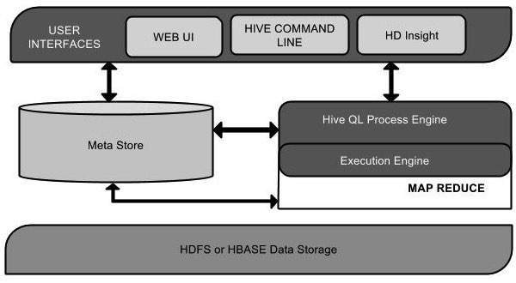
HIVE Architecture

Slide 11
HIVE
Command-Line Interface
HIVE web interface
HIVE server (Thrift)
Driver (Query Compiler, executor)
Metastore
Job Traker
Task Tracker
HDFS
Hadoop
HIVE Architecture

Slide 12
User Interface
Hive is a data warehouse infrastructure software that can create interaction between user and HDFS.
The user interfaces that Hive supports are Hive Web UI, Hive command line, and Hive HD Insight (In Windows server).
HIVE command-Line Interface (Hive CLI): The most commonly used interface to interact with HIVE.
Hive Web Interface: It is a simple Graphic user Interface to interact with Hive and to execute query.
Hive Server: This is an optional server. This can be used to submit Hive jobs from a remote client.

Slide 13
Meta Store
Hive chooses respective database servers to store the schema or Metadata of tables, databases, columns in a table, their data types, and HDFS mapping.
Meta store consists of the following:
Metastore service: Offers interface to the Hive.
Database: Stores data definitions, mappings to the data and others.

Slide 14
HiveQL Process Engine
HiveQL is similar to SQL for querying on schema info on the Metastore. It is one of the replacements of traditional approach for MapReduce program. Instead of writing MapReduce program in Java, we can write a query for MapReduce job and process it.

Slide 15
Execution Engine
The conjunction part of HiveQL process Engine and MapReduce is Hive Execution Engine. Execution engine processes the query and generates results as same as MapReduce results. It uses the MapReduce.

Slide 16
HDFS or HBASE
Hadoop distributed file system or HBASE are the data storage techniques to store data into file system.

Slide 17
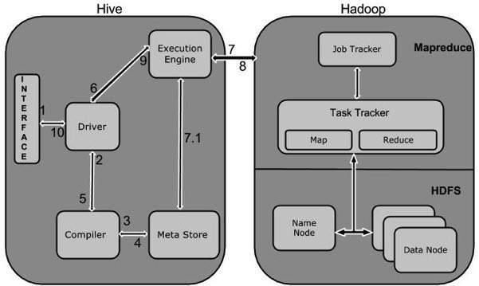
Working of Hive

Slide 18
Metastore
There are three kinds of metastore.
Embedded Metastore
Local Metastore
Remote Metastore

Slide 19
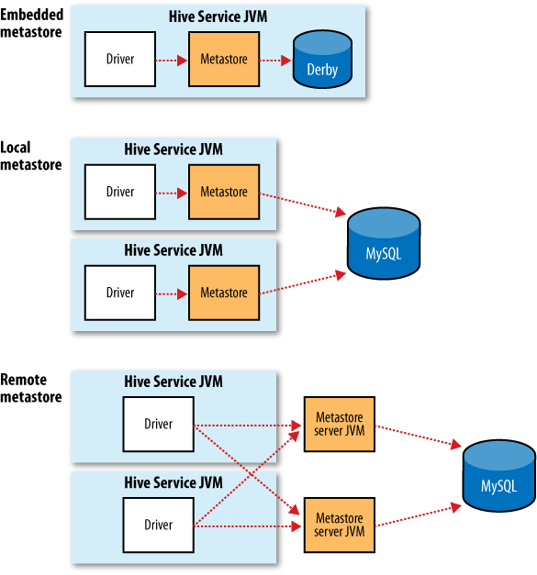

Slide 20
Embedded Metastore
This metastore is mainly used for unit tests.
Here one process is allowed to connect to the
metastore at a time.
This is the default metastore for HIVE.
It is Apache Derby Hive Server Process.
Metastore

Slide 21
Local Metastore Metastore
Metadata can be stored in any RDBMS component like MySQL.
Local Metastore allows multiple connections at a time.
In this mode, the Hive metastore service runs in the main Hive Server process,
but he metastore database runs in a separate process on separate host.

Slide 22
Remote Metastore
The Hive driver and the metastore interface run on different JVMs.
The databased can be fire-walled from the Hive User and also database
credentials are completely isolated from the users of Hive.

Slide 23
Hive Data Types
All the data types in Hive are classified into four types, given as follows:
Column Types
Literals
Null Values
Complex Types
Column Types
Column type are used as column data types of Hive. They are as follows:
Integral Types
String Types
Dates
Decimals
Integer type data can be specified using integral data types, INT. When the data range exceeds the range of INT, you need to use BIGINT and if the data range is smaller than the INT, you use SMALLINT. TINYINT is smaller than SMALLINT.
The following table depicts various INT data types:
Type Postfix Example
TINYINT Y 10Y
SMALLINT S 10S
INT - 10
BIGINT L 10L

Slide 24
String Types
String type data types can be specified using single quotes (' ') or double quotes (" ").
It contains two data types: VARCHAR and CHAR.
Hive follows C-types escape characters.
The following table depicts various CHAR data types:
Data Type Length
VARCHAR 1 to 65355
CHAR 255
Timestamp
It supports traditional UNIX timestamp with optional nanosecond precision. It supports java.sql.Timestamp format “YYYY-MM-DD HH:MM:SS.fffffffff” and format “yyyy-mm-dd hh:mm:ss.ffffffffff”.

Slide 25
Dates
DATE values are described in year/month/day format in the form {{YYYY-MM-DD}}.
Decimals
The DECIMAL type in Hive is as same as Big Decimal format of Java. It is used for representing immutable arbitrary precision. The syntax and example is as follows:
DECIMAL(precision, scale) decimal(10,0)
Union Types
Union is a collection of heterogeneous data types. You can create an instance using create union. The syntax and example is as follows:
UNIONTYPE<int, double, array<string>, struct<a:int,b:string>> {0:1} {1:2.0} {2:["three","four"]} {3:{"a":5,"b":"five"}} {2:["six","seven"]} {3:{"a":8,"b":"eight"}} {0:9} {1:10.0}

Slide 26
Complex Types
The Hive complex data types are as follows:
Arrays
Arrays in Hive are used the same way they are used in Java.
Syntax: ARRAY<data_type>Maps
Maps in Hive are similar to Java Maps.
Syntax: MAP<primitive_type, data_type>Structs
Structs in Hive is similar to using complex data with comment.
Syntax: STRUCT<col_name : data_type [COMMENT col_comment], ...>

Slide 27
HIVE FILE FORMAT
Text File
Each record is a line in the file.
Different control characters are used as delimiters.
CSV, TSV , JSON or XML
Sequential File
Sequential files are flat files that store binary key-value pairs. It includes compression.
RCFile (Record Columnar File)

Slide 28
RC File (Record Columnar File)
RC File stores the data in Column oriented manner which ensures that aggregation operation is not an expensive operation.
RC file first partitions horizontally and then vertically to serialize the data.
C1 c2 c3 c4
11 12 13 14
21 22 23 24
31 32 33 34
41 42 43 44
51 52 53 54

Slide 29
Table with two row groups
C1 c2 c3 c4 c1 c2 c3 c4
11 12 13 14 41 42 43 44
21 22 23 24 51 52 53 54
31 32 33 34
Table in RCFile format
Rowgroup 1 row group 2
11,21,31; 41,51;
12,22,32; 42,52;
13,23,33; 43,53;
14,24,34; 44,54;

Slide 30
HIVE Query Language (HQL)
Create and manage tables and partitions
Support various Relational , arithmetic and logical operators.
Evaluate functions
Download the content of a table to a local directory or result of queries to HDFS directory.

Slide 31
Data Definition Language(DDL)
These statements are used to build and modify the tables and other objects.
Create/Drop/alter database
Create/drop/truncate table
Alter table/partition/column
Create/drop/alter view
Create/drop/alter index
Show
describe

Slide 32
DML Data Manipulation statements
To retrieve, store, modify, delete and update the data in database.
The DML commands are as follows:
Loading files into table.
Inserting data into hive tables from queries.

Slide 33
Databases
To create a database names students with comments and database properties.
Create database if not exists students comment ‘student details’ with dbproperties (‘creator’ = ‘john’);
Create database student;
It will create in the default location /user/hive/warehouse.
To display a list of all databases
Show databases;
To describe a database
Describe database students;
To describe the extended database
Describe database extended students;
To alter the database properties
Alter database students set dbproperties(‘edited-by’ = ‘james’);
To make the database as current working database
Use students;

Slide 34
Tables
Hive provides two kinds of tables:
Managed tables
External tables
Managed tables
Hive stores the managed tables under the warehouse folder under Hive.
The complete life cycle is managed by Hive.
When the internal table is dropped, it drops the data as well as the metadata.

Slide 35
Create table
CREATE TABLE IF NOT EXISTS STUDENT
(rollno INT, name STRING, gpa FLOAT) ROW FORMAT DELIMITED FIELDS TERMINATED BY ’\t’;
DESCRIBE STUDENT;
Rollno int
Name string
Gpa float

Slide 36
External or self-managed tables
When the table is dropped, it retains the data in the underlying location.
Create external table if not exists ext_student (rollno int, name string, gpa float) row format delimited fields terminated by “\t” location ‘/student’
TO load data into table from file
Load data local inpath ‘/root/file.tsv’ overwrite into table ext_student;
LOCAL keyword is used to load the data from local file system.
To load the data from HDFS remove the local keyword

Slide 37
Query
Select * from ext_student;
Select rollno,name from student;

Slide 38
Collection Data Types
CREATE TABLE STUDENT_INFO (rollno int, name string, marks MAP<string,int>) ROW FORMAT DELIMITED FIELDS TERMINATED BY ',' COLLECTION ITEMS TERMINATED BY':' MAP KEYS TERMINATED BY '!';
LOAD DATA LOCAL INPATH '/root/hivedemos/studentinfo.csv' INTO TABLE STUDENT_INFO;
1001,John,sub1!56:sub2!78:sub3!60

Slide 39
QUERYING TABLE WITH COLLECTION DATA TYPES
SELECT * from STUDENT_INFO;
SELECT name,marks['sub1'] from STUDENT_INFO;

Slide 40
USING ARRAYS
CREATE TABLE STUDENT_INFO (rollno int, name string,friends ARRAY<STRING>,marks MAP<string,int>) ROW FORMAT DELIMITED FIELDS TERMINATED BY ',' COLLECTION ITEMS TERMINATED BY':' MAP KEYS TERMINATED BY '!';
LOAD DATA LOCAL INPATH '/root/hivedemos/studentinfo.csv' INTO TABLE STUDENT_INFO;
1001,John,JAMES:RAJU,sub1!56:sub2!78:sub3!60
SELECT NAME,FRINDS[0] FROM STUDENT_INFO;

Slide 41
Partitions
In Hive the query reads the entire dataset even though a where clause filter is specified on a particular column.
This becomes a bottleneck in most of the MapReduce jobs as it involves huge degree of I/O.
To reduce I/O required by the MapReduce job to improve the performance of the query.
Partitions split the larger dataset into more meaningful chunks.

Slide 42
Hive provides two kinds of partitions: static and dynamic partitions.
Static : static partitions comprise columns whose values are known at compile time.
CREATE TABLE IF NOT EXISTS STATIC_PART (ROLLNO INT, NAME STRING) PARTITIONED BY (GPA FLOAT) ROW FORMAT DELIMITED FIELDS TERMINATED BY ‘\t’;

Slide 43
Insert input data files individually into a partition table is Static Partition
Usually when loading files (big files) into Hive tables static partitions are preferred
Static Partition saves your time in loading data compared to dynamic partition You “statically” add a partition in table and move the file into the partition of the table.
We can alter the partition in static partition
You can get the partition column value form the filename, day of date etc without reading the whole big file.
If you want to use Static partition in hive you should set property
set hive.mapred.mode = strict
This property set by default in hive-site.xml Static partition is in Strict Mode
You should use where clause to use limit in static partition
You can perform Static partition on Hive Manage table or external table.

Slide 44
TO LOAD DATA INTO PARTITION TABLE FROM TABLE
INSERT OVERWRITE TABLE STATIC_PART_STUDENT PARTITION(GPA=4.0) SELECT ROLLNO,NAME FROM EXT_Student where gpa=4.0;
ALTER TABLE STATIC_PART_Student add partition (gpa=3.5);
Insert overwrite table static_part_student partition (gpa=4.0) select rollno, name from ext_student where gpa=4.0;

Slide 45
static partitioning
We need to specify the partition column value in each and every LOAD statement.
Suppose we are having partition on column country for table t1(userid, name,occupation, country), so each time we need to provide country value
hive>LOAD DATA INPATH '/hdfs path of the file' INTO TABLE t1 PARTITION(country="US")
hive>LOAD DATA INPATH '/hdfs path of the file' INTO TABLE t1 PARTITION(country="UK")

Slide 46
DYNAMIC PARTITIONS
Dynamic Partition have columns whose values are known only at Execution Time.
To create dynamic partition on column gpa.
CREATE TABLE IF NOT EXISTS DYNAMIC_PART_STUDENT (rollno int, name string) partitioned by (gpa float) row format delimited fields terminated by ‘\t’;
To load data into dynamic partition table from table.
Set hive.exec.dynamic.partition=true;
Set hive.exec.dynamic.partition.mode=nonstrict;
INSERT OVERWRITE TABLE DYNAMIC_PART PARTITION (GPA) SELECT rollno,name,gpa from ext_Student;

Slide 47
Dynamic Partition
It allow us not to specify partition column value each time.
The approach we follows is as below:
create a non-partitioned table t2 and insert data into it.
now create a table t1 partitioned on intended column(say country).
load data in t1 from t2 as below:
hive> INSERT INTO TABLE t2 PARTITION(country) SELECT * from T1;
make sure that partitioned column is always the last one in non partitioned table(as we are having country column in t2)

Slide 48
Bucketing
In a partition, it will create a partition for each unique value of the column.
This may lead to situations where you may end up with thousands of partitions.
This can be avoided by using bucketing in which you can limit the number of buckets to create.
A bucket is a file whereas a partition is a directory.
Set hive.enforce.bucketing=true
Crate table if not exists student (rollno int,name string, grade float) clustered by (grade) into 3 buckets;

Slide 49
LOAD DATA TO BUCKETED TABLE
FROM STUDENT INSERT OVERWRITE TABLE STUDENT_BUCKET SELECT rollno, name, grade;
To display content of first bucket
SELECT DISTINCT GRADE FROM STUDENT_BUCKET TABLESAMPLE(BUCKET 1 OUT OF 3 ON GRADE)

Slide 50
VIEWS
In HIVE VIEW support is available after 0.6. Views are purely logical object.
CREATE VIEW STUDENT_VIEW AS SELECT rollno,name from EXT_Student;
SELECT * FROM STUDENT_VIEW LIMIT 4;
DROP VIEW STUDENT_VIEW;

Slide 51
SUB-QUERY
In hive sub-queries are supported in the FROM CLAUSE. You need to specify name for sub-query because every table in a FROM clause has a name.
Write a subquery to count the occurrence of similar words in the file.
CREATE TABLE docs (line STRING);
Load data local inpath ‘/root/hivedemo/lines.txt’ OVERWRITE INTO TABLE docs;
CREATE TABLE word_count AS SELECT word, count(1) as count from (select explode(split(line,’ ‘) ) AS word FROM docs) w GROUP BY WORD
ORDER BY WORD;
SELECT * FROM word_count;

Slide 52
joins
Joins in hive is similar to the SQL join.
To join student and department
CREATE TABLE IF NOT EXISTS STUDENT (rollno int, name string, gpa float) ROW FORMAT DELIMITED FIELDS TERMINATED BY ‘\t’;
LOAD DATA LOCAL INPATH ‘/ROOT/HIVEDEMOS/STUDENT.TSV’ OVERWRITE INTO TABLE STUDENT;
CREATE TABLE IF NOT EXISTS DEPARTMENT (rollno int , deptno int, name string) ROW FORMAT DELIMITED FIELDS TERMINATED BY ‘\t’;
LOAD DATA LOCAL INPATH ‘/ROOT/HIVEDEMOS/DEPARTMENT.TSV’ OVERWRITE INTO TABLE DEPARTMENT;
Select a.rollno, a.name, a.gpa , b.deptno FROM STUDENT A JOIN DEPARTMENT B ON A.ROLLNO=B.ROLLNO;

Slide 53
AGGREGATION
HIVE SUPPORTS aggregation functions like avg, count etc.
SELECT AVG(GPA) FROM STUDENT;
SELECT COUNT(*) FROM STUDENT;

Slide 54
GROUP BY AND HAVING
DATA in a column or columns can be grouped on the basis of values by using “group by”. Having clause is used to filter out groups NOT meeting the specified conditions.
SELECT rollno, name, gpa FROM STUDENT GROUP BY rollno,name,gpa HAVING gpa>4.0;

Slide 55
RCFILE implementation
RC FILE (Record Columnar file ) is a data placement structure that determines how to store relational tables on computer clusters.
CREATE TABLE STUDENT_RC (rollno int, name string, gpa float) STORED AS RCFILE;
INSERT OVERWRITE table STUDENT_RC SELECT * FROM STUDENT;
SELECT SUM(GPA) FROM STUDENT_RC;

Slide 56
SERDE
SERDE STANDS FOR SERIALIZATION AND DESERIALIZATION
CONTAINS the logic to convert unstructured data into records
Implemented using java
Serializers are used at the time of writing
Deserializers are used at query time (select statement)
Serializer takes a java object that hive has been working with and translates it into something that Hive can write into HDFS
Deserializer interface takes a binary representation or string of a record, converts it into a java object that Hive can then manipulate.

Slide 57
To manipulate the XML data
CREATE TABLE XMLSAMPLE(XMLDATA STRING);
LOAD DATA LOCAL INPATH ‘/ROOT/HIVEDEMOS/INPUT.XML’ INTO TABLE XMLSAMPLE;
CREATE TABLE xpath_table as SELECT XPATH_INT(XMLDATA,’EMPLOYEE/EMPID’), XPATH_STRING(XMLDATA, ‘employee/name’),
XPATH_STRING(XMLDATA, ‘employee/designation’)
From xmlsample;
Select * from xpath_table;

Slide 58
User Defined Functions
We can use custom functions by defining the User-Defined Function (UDF)
1. Write java code
Import org.apache.hadoop.hive.ql.exec.UDF;
Convert java program into jar
Then execute

